Slide 1
Chapter 3
Digital Logic Structures
Transistors
Logic gates & Boolean logic
Combinational logic
Storage Elements
Memory

Slide 2
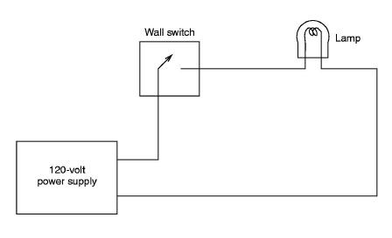
Electronic ones and zeros
An electronic switch
  like a light switch or faucet
  switches between insulator (open circuit) and conductor (closed circuit)
  We can call the presence of a voltage “1” and its absence “0”

Slide 3
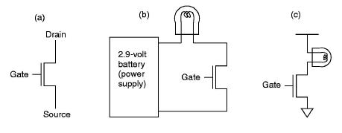
Transistors
An electronic switch that is open or closed between the source and the drain depending on the voltage on the gate.

Slide 4
CMOS Transistors
CMOS
  = Complementary Metal-Oxide Semiconductor
  Standard type for digital applications
  Two versions: P-type (positive) and N-type (negative)
  P and N-type transistors operate in inverse modes
P
N
A
A
G
G
B
B
Open (insulating) if gate is “on” = 1
Closed (conducting) if gate is “off” = 0
Open (insulating) if gate is “off” = 0
Closed (conducting) if gate is “on” = 1

Slide 5
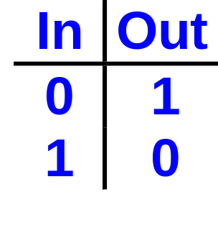
Inverter Gate
2.9 v
  When the input is on (in = high voltage), the P-type transistor is open and the N-type is closed, so the output is off (out = low voltage).
  Vice-versa: when the Input is off (in = low voltage), the output is connected to the high voltage.
P
in
out
N
0 v

Slide 6
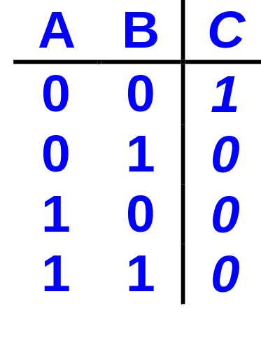
NOR Gate
2.9 v
A
P
B
P
C
N
N
0 v
0 v

Slide 7
NOR Gate - Operation
2.9 v
2.9 v
2.9 v
0 v
2.9 v
P
2.9 v
P
P
0 v
P
2.9 v
P
0 v
P
2.9 v
0 v
0 v
N
N
N
N
N
N
0 v
0 v
0 v
0 v
0 v
0 v

Slide 8
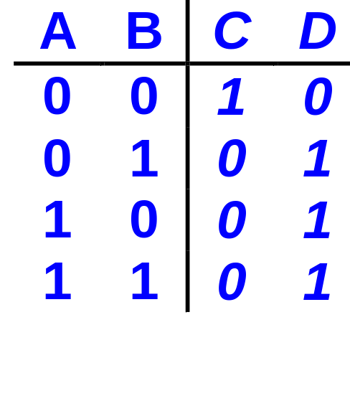
OR Gate
= a NOR gate followed by an inverter
A
B
C
D

Slide 9
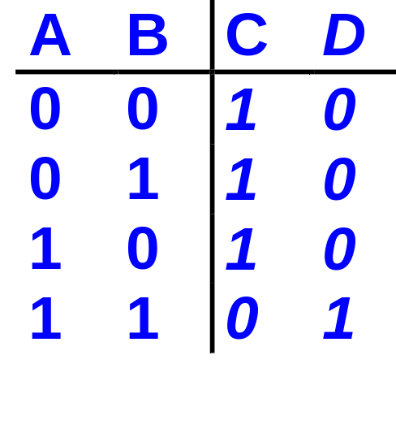
NAND & AND Gates
A
B
C
D

Slide 10
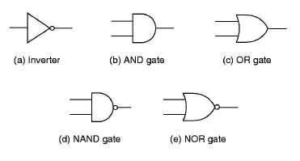
Logic Gates & Symbols
Note that gates can have more than 2 inputs.

Slide 11

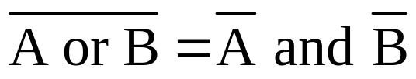
De Morgan’s Law
not(A and B) = (not A) or (not B)
not(A or B) = (not A) and (not B)
=
=

Slide 12
Completeness
It can be shown that any truth table (i.e. any binary function of two variables) can be reduced to combinations of the AND & NOT functions, or of the OR & NOT functions.
    This result extends also to functions of more than two variables
In fact, it turns out to be convenient to use a basic set of three logic gates:
  AND, OR & NOT
  or
  NAND, NOR & NOT

Slide 13
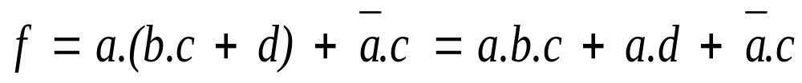
Representation of Logic Functions
A logic function can be represented as
  a truth table
  a logic expression
  a logic circuit
Example
a
b
c
d
f
0
0
0
0
0
0
0
0
1
0
0
0
1
0
1
0
0
1
1
1
0
1
0
0
0
0
1
0
1
0
0
1
1
0
1
0
1
1
1
1
1
0
0
0
0
a
1
0
0
1
1
b
1
0
1
0
0
c
1
0
1
1
1
f
1
1
0
0
0
d
1
1
0
1
1
1
1
1
0
1
1
1
1
1
1

Slide 14
Types of Logic Structures
  Two types of logic structures ==> two types of logic circuits
    Decision structures: can make a decision based only on the current inputs: gates belong to this category.
    Storage structures: permit the storage of information (as bits).
  Combinational logic circuits
    a combinational logic structure is constructed from decision elements only: i.e. simple gates or other combinational logic circuits.
    its output depends solely on its current input.
  Sequential logic circuits
    combine combinational circuits & storage devices - we’ll deal with these shortly.
  Four examples of combinational logic circuits
    Decoder
    Multiplexer (MUX)
    Full adder
    Programmable Logic Array

Slide 15
Decoder
A
  An n input decoder has 2^{n} outputs.
  Output_{i} is 1 iff the binary value of the n-bit input is i.
  At any time, exactly one output is 1, all others are 0.
i = 0
1, iff A,B is 00
B
i = 1
1, iff A,B is 01
i = 2
1, iff A,B is 10
i = 3
1, iff A,B is 11

Slide 16
Multiplexer (MUX)
A
B
C
D
  In general, a MUX has
    2^{n} data inputs
    n select (or control) lines
    and 1 output.
  It behaves like a channel selector.
S₀
S₁
A
B
C
D
Out
S[1:0]
A 4-to-1 MUX:
Out takes the value of A,B, C or D
depending on the value of S (00, 01, 10, 11)
Out

Slide 17
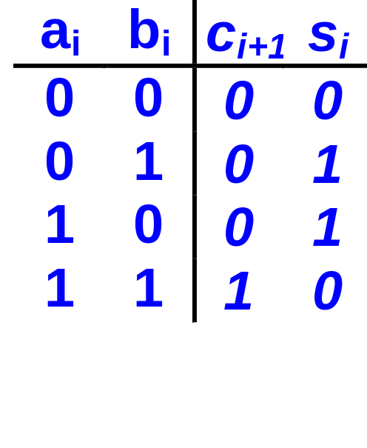
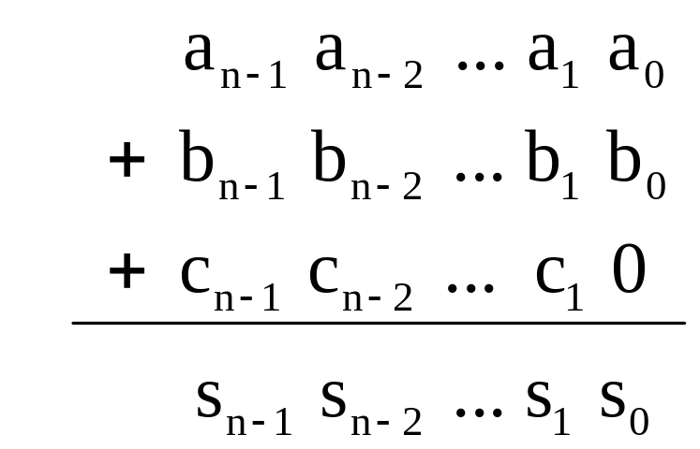
Adder
Half Adder
  2 inputs
  2 outputs: sum and carry
Full Adder
  performs the addition in column i
  3 inputs: a_{i}, b_{i} and c_{i}
  2 outputs: s_{i} and c_{i+1}
  c_{i} is the carry in from bit position i-1
  c_{i+1} is the carry out to bit position i+1
Half-adder truth table

Slide 18
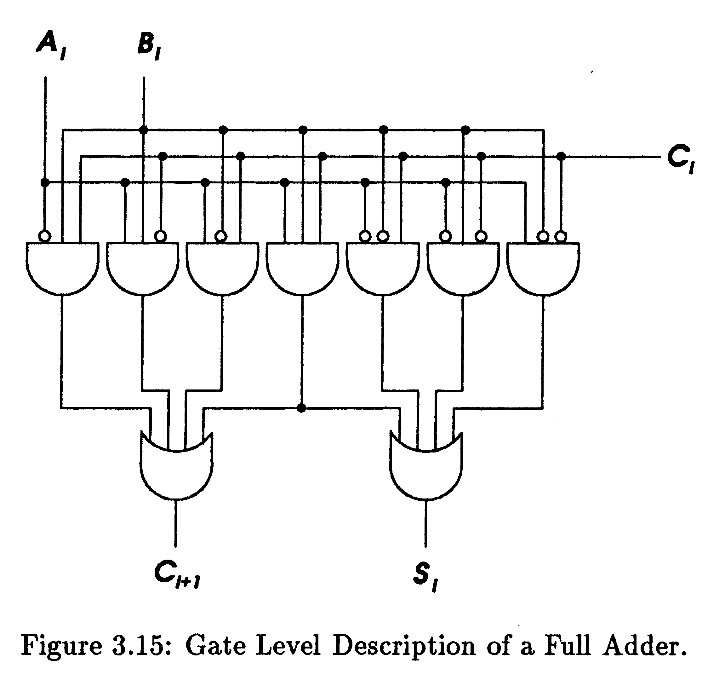
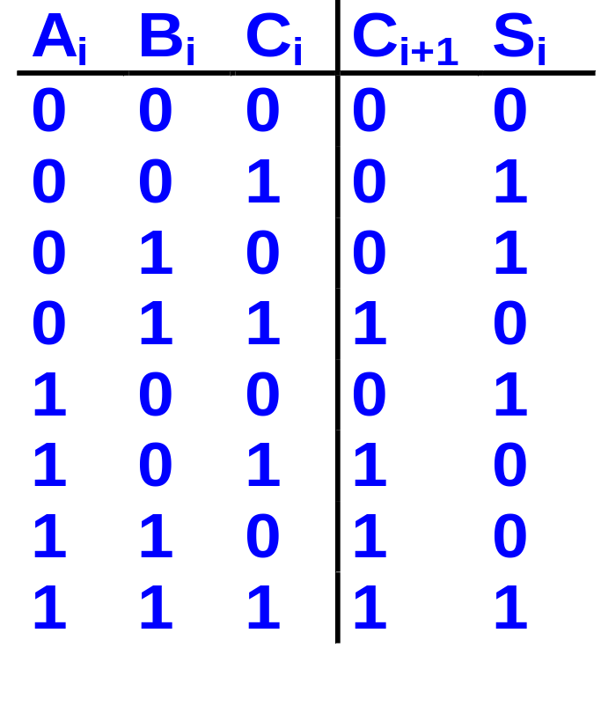
Gate Level Full Adder

Slide 19
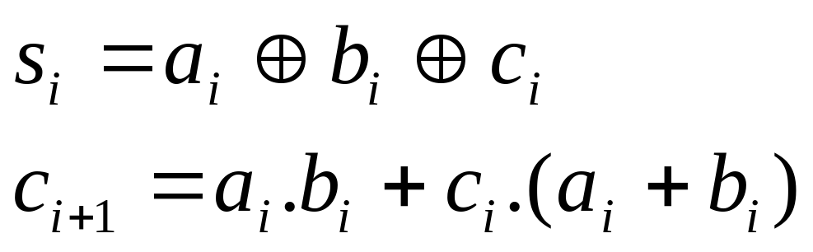
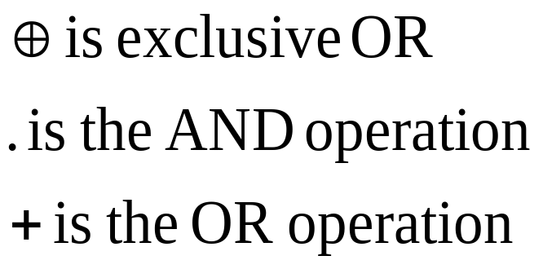
Full Adder - Expressions
where
- verify that this corresponds to the gate-level implementation.

Slide 20
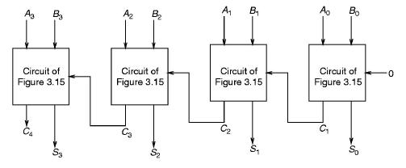
A 4-bit Ripple-Carry Adder

Slide 21
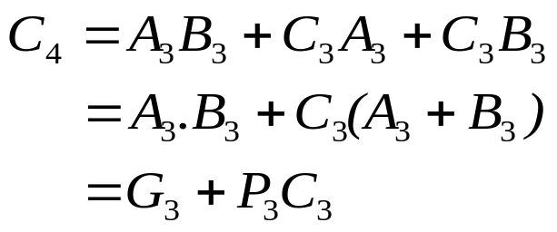
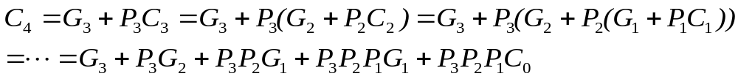
Carry Lookahead Addition
We can pre-compute the carry
  The carry in bit 4 (C₄) is 1 if any two of A₃, B₃ or C₃ are 1.
  P₃ is called the propagate bit, and G₃ the generate bit
  So every carry bit can be pre-computed using all the previous inputs.
  Pre-computation can be done in 2 gate delays.

Slide 22
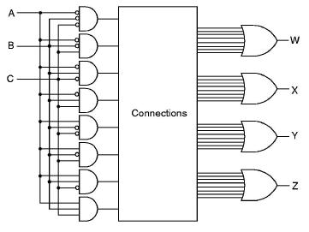
Programmable Logic Array
It is possible to build a logic circuit that uses logic circuits to decide what logic circuits to implement!

Slide 23
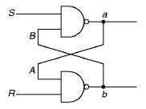
Storage Elements: R-S Latch
0
1
1
0
0
1
1
0
The output a of the R-S latch can be set to 1 by momentarily setting S to 0 while keeping R at 1.
When S is set back to 1 the output a stays at 1.
Conversely, the output a can be set to 0 by keeping S at 1 and momentarily setting R to 0.
When R is set back to 1, the output a stays at 0.
The flip-flop (R-S latch) is a bi-stable element

Slide 24
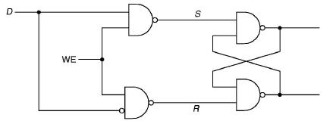
Storage Elements: Gated D Latch
The gated D latch is an extension of the R-S latch
Two inputs: data (D) and write enable (WE)
When the WE (write enable) is set to 1, the output of the latch
is set to the value of D.
The output is held until WE is “asserted” (set to 1) again.

Slide 25
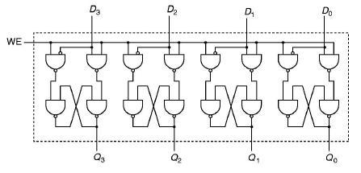
Registers
A 4-bit register made of four D latches

Slide 26
Memory - 1
  A large number of addressable fixed size locations
Address Space
n bits allow the addressing of 2^{n} memory locations.
  Example: 24 bits can address 2²⁴ = 16,777,216 locations
  (i.e. 16M locations).
  If each location holds 1 byte (= 8 bits) then the memory is 16MB.
  If each location holds one word (32 bits = 4 bytes) then it is 64 MB.

Slide 27
Memory - 2
Addressability
  Computers are either byte or word addressable - i.e. each memory location holds either 8 bits (1 byte), or a full standard word for that computer (16 bits for the LC-3, more typically 32 bits, though now many machines use 64 bit words).
  Normally, a whole word is written and read at a time:
    If the computer is word addressable, this is simply a single address location.
    If the computer is byte addressable, and uses a multi-byte word, then the word address is conventionally either that of its most significant byte (big endian machines) or of its least significant byte (little endian machines).

Slide 28
Building a Memory
A[1:0]
D
Each bit
  is a gated D-latch
Each location
  consists of w bits (here w = 1)
  w = 8 if the memory is byte addressable
Addressing
  n locations means log₂n address bits (here 2 bits => 4 locations)
  decoder circuit translates address into 1 of n locations
WE

Slide 29
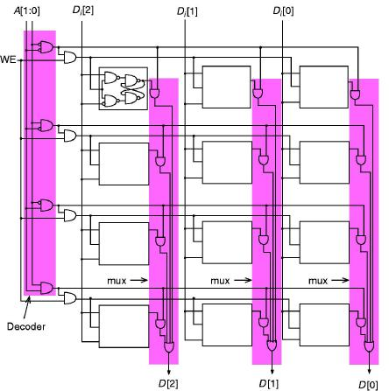
Memory Example
A 2² by 3 bits memory:
two address lines: A[1:0]
three data lines: D[2:0]
one control line: WE
One gated D-latch

Slide 30
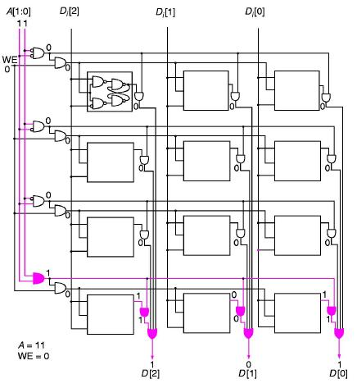
Reading a location in memory

Slide 31
Using Memory Building Blocks
  Building an 8K byte memory using chips that are 2K by 4 bits.
CS = chip select:
  when set, it enables the addressing, reading and writing of that chip.
A10-A0
2K x 4 bits
2K x 4 bits
CS
CS
decoder
2K x 4 bits
2K x 4 bits
CS
CS
A12-A11
2K x 4 bits
2K x 4 bits
CS
CS
This is an 8KB
byte addressable memory
2K x 4 bits
2K x 4 bits
CS
CS

Slide 32
Memory One Word Wide
Use the previous memory block of 8K x 1 byte to build a memory that is 64K words, with each location one word of 32 bits.
  what are the address lines if the memory is word addressed? or byte addressed?
A? - A?
8K x 1B
decoder
A? - A?

Slide 33
Sequential Logic Circuits - 1
The concept of state
  the state of a system is a “snapshot” of all relevant elements at a moment in time.
  a given system will often have only a finite number of possible states.
  e.g. the game of tic-tac-toe has only a certain number of possible dispositions of Xs and Os on the 3x3 grid.
  A given game of tic-tac-toe will progress through a subset of these possible states (until someone wins) - i.e. it traverses a specific path through “state space”, one move at a time.
  For many systems, we can define the rule which determine under what conditions a system can move from one state to another.

Slide 34
Sequential Logic Circuits - 2
input
Combinational
Logic Circuit
output
Storage
Element
  The output is a function of the current input and the previous state
  It is computed by the combinational logic circuit
  The state is stored in the storage element
  The new state is also a function of the previous state and the current input
  This can work only if we make transitions from one state to another at well-defined times - this is why they are called sequential circuits.

Slide 35
Finite State Machines
Many systems meet the following five conditions:
  A finite number of states
  A finite number of external inputs
  A finite number of external outputs
  An explicit specification of all allowed state transitions
  An explicit specification of the rules for each external output value
In fact, as we will see, a microprocessor is a perfect candidate for description as a FSM.

Slide 36
Finite State Machine Example - 1
0
1
01
all off
grp 1 on
00
0
DETOUR
1
0
10
0,1
all on
grp 1,2 on
  Three groups of lights to be lit in a sequence: group 1 on, groups 1 & 2 on, all groups on, all off.
  The lights are on only if the main switch is on.
  Four states: so we need two bits to identify each state.
11
1
switch
out1
out2
out3
Combinational
Logic Circuit
S
2
2
d[1:0]
Two bit
Storage
clock

Slide 37
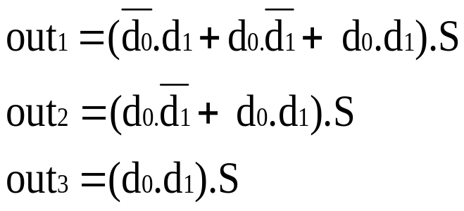
Finite State Machine Example - 2
When is group 1 on?
  in states 01, 10 and 11 - but only when the switch is on!
  can you come up with a logic expression for d₀ and d₁?
When do we switch to the next state?
  the two bits of d[1:0] are updated at every clock cycle
  we have to make sure that the new state does not propagate to the combinational circuit input until the next clock cycle.

Slide 38
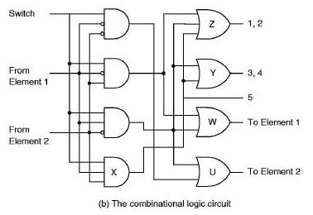
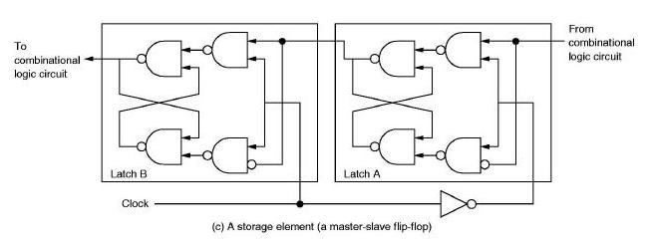
Finite State Machine Example - 3

Slide 39
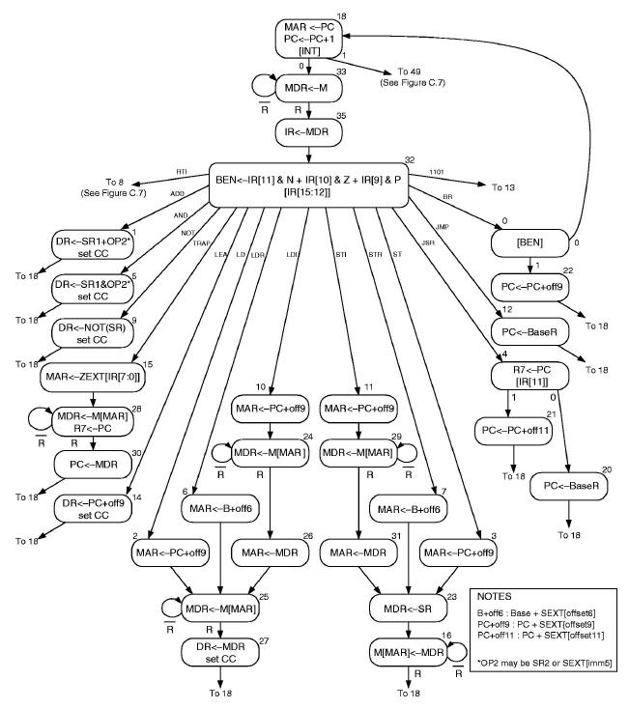
The LC-3 as a Finite State Machine

Slide 40
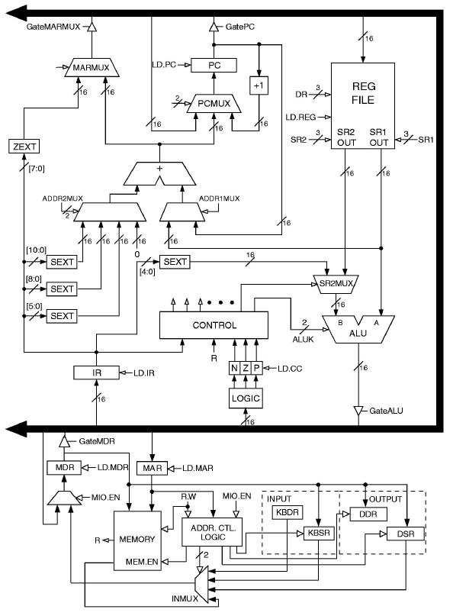
Data Path of the LC-3

